Slide 1
19CSE211-Computer Architecture & Organization Conversion of MIPS Instruction to Machine Language Representation

Slide 2
Logical Operations
Instructions for bitwise manipulation
Operation | C | Java | MIPS
Shift left | << | << | sll
Shift right | >> | >>> | srl
Bitwise AND | & | & | and, andi
Bitwise OR | | | | | or, ori
Bitwise NOT | ~ | ~ | nor

Slide 3
MIPS Shift Operations
Shifts move all the bits in a word left or right
sll $t2, $s0, 8 #$t2 = $s0 << 8 bits
srl $t2, $s0, 8 #$t2 = $s0 >> 8 bits
Instruction Format (R format)
Such shifts are called logical because they fill with zeros
Notice that a 5-bit shamt field is enough to shift a 32-bit value
Notes:
also have sllv, srlv, and srav

Slide 4
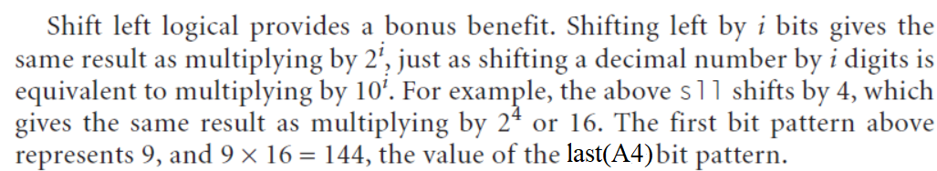
MIPS Shift Operations-Example of sll Instruction
sll $t0,$s0,4 is to be executed and if register $s0 contained :
(0000 0000 0000 0000 0000 0000 0000 1001)two= (9)ten→ A
(0 000 0000 0000 0000 0000 0000 0000 10010)-sll by 1 bit- (18)ten→A1
(0 00 0000 0000 0000 0000 0000 0000 100100)-sll by 2 bits- (36)ten→A2
(0 0 0000 0000 0000 0000 0000 0000 1001000)-sll by 3 bits- (72)ten→A3
(0000 0000 0000 0000 0000 0000 1001 0000)-sll by 4 bits-(144) ten →A4

Slide 5
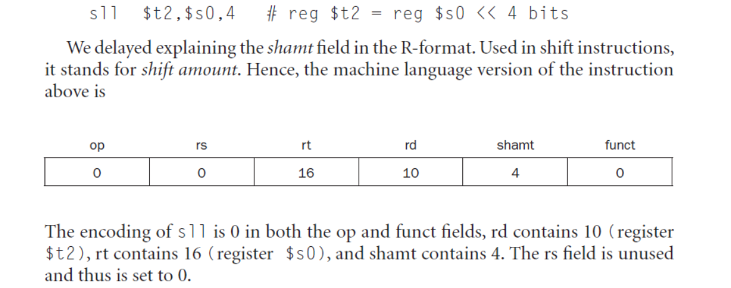
Machine Language Representation for ‘sll’ Instruction

Slide 6
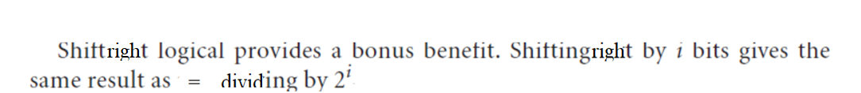
MIPS Shift Operations-Example of srl Instruction
srl $t0,$s0,4 is to be executed and if register $s0 contained :
(0000 0000 0000 0000 0000 0000 1001 0000)two= (144)ten → A
(00 0000 0000 0000 0000 0000 0000 1001000)-srl by 1 bits- (72)ten → A1
(000 0000 0000 0000 0000 0000 0000 100100)-srl by 2 bits- (36)ten → A2
(0000 0000 0000 0000 0000 0000 0000 10010)-srl by 3 bit- (18)ten → A3
(0000 0000 0000 0000 0000 0000 0000 1001)two= (9)ten->A4

Slide 7
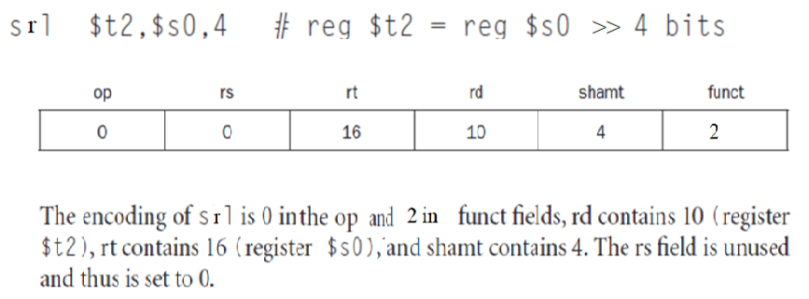
Machine Language Representation for ‘srl’ Instruction

Slide 8
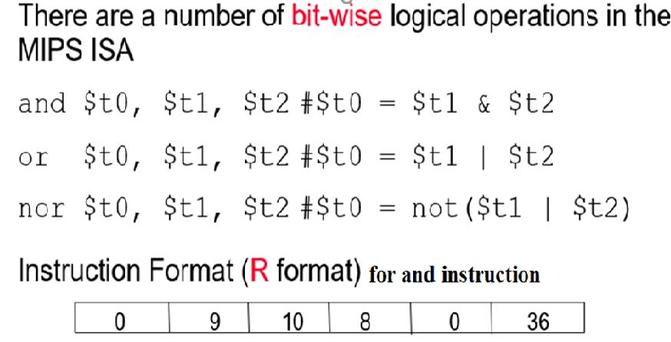
MIPS Logical Operations

